Slide 1
Lecture 5 Controlled Sources (1)
Hung-yi Lee

Slide 2
Textbook
Chapter 2.3, 3.2

Slide 3
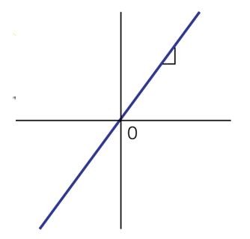
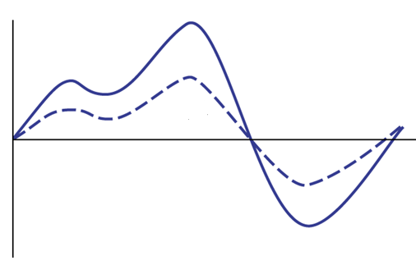
Voltage Amplifier
Voltage amplifier
Notes:
Pickup to loudspeaker
Cell phone

Slide 4
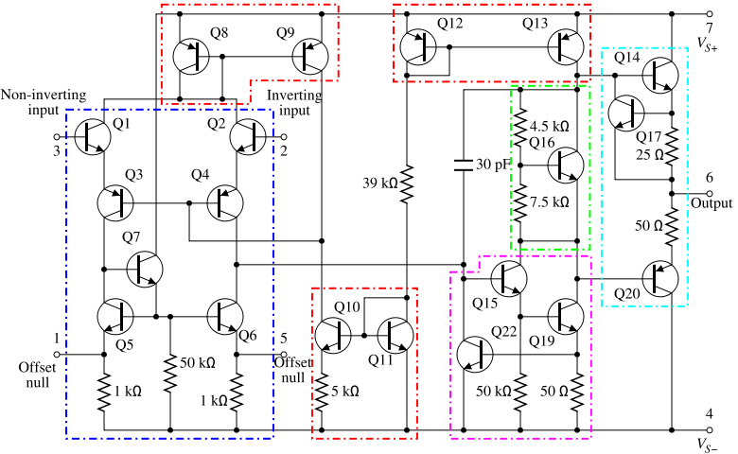
Voltage Amplifier
A
C
B
Voltage amplifier
D
A
C
B
D

Slide 5
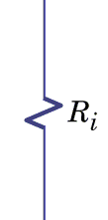
Voltage Amplifier
A
C
B
Voltage amplifier
D
A
C
Voltage controlled voltage source
B
D
Notes:
voltage amplifier still need power!

Slide 6
Current Amplifier
Current amplifier
Current controlled Current source

Slide 7
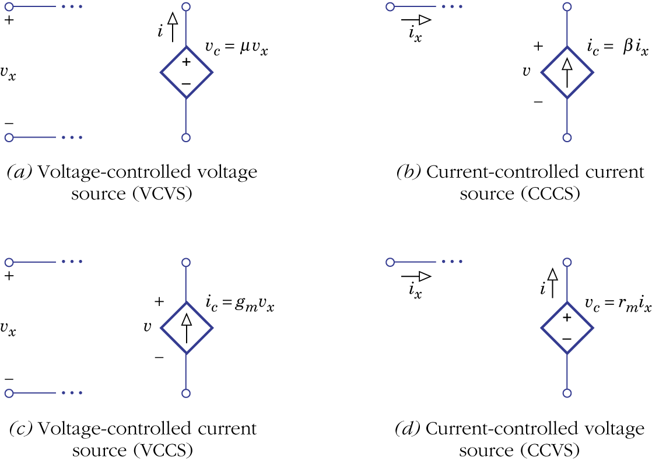
Controlled Sources
independent
sources

Slide 8
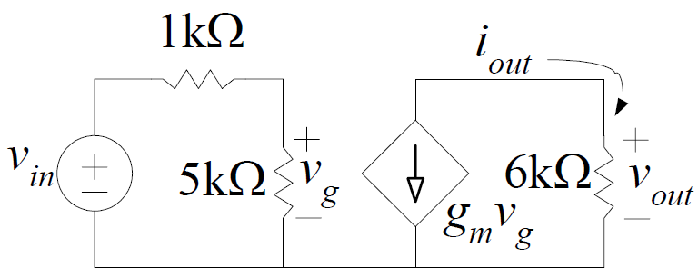
Controlled Sources – Example 2.6
g_{m} = 5x10⁻³
Find v_{out}/v_{in}
open

Slide 9
Controlled Sources – Example 3.4
Find v_{out}/v_{s}

Slide 10
Homework
3.16
3.18

Slide 11
Thank you!

Slide 12
Answer
3.16
4k, 8
3.18
0.5k, -7

Slide 13
Acknowledgement
感謝 鐘杰(b02)
修正作業 3.16 投影片中所附的圖

